Slide 1
SonarQube Binding

Slide 2
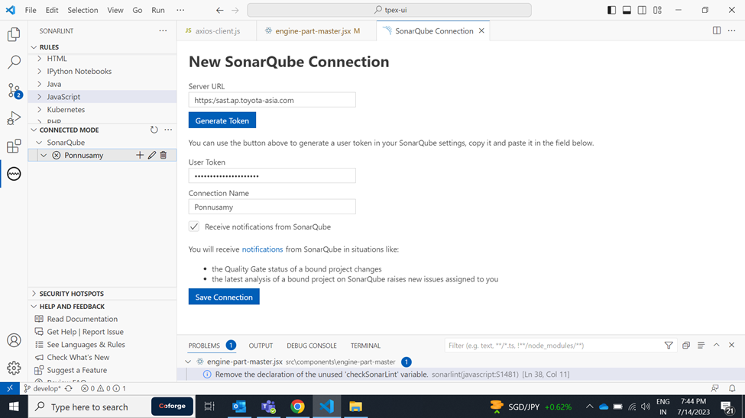
Ponnusamy

Slide 3
UI - Team
Name | email
Ponnusamy | ponnusamy@coforge.com
Raman Hira
Akanksha Maurya | Akanksha.maurya@coforge.com
MOHD IMRAN | Mohd.3.Imran@coforge.com
Pramod Kumar | Pramod.2.kumar@coforge.com
Bathula Yedukondalu | bathula.y@coforge.com

Slide 4
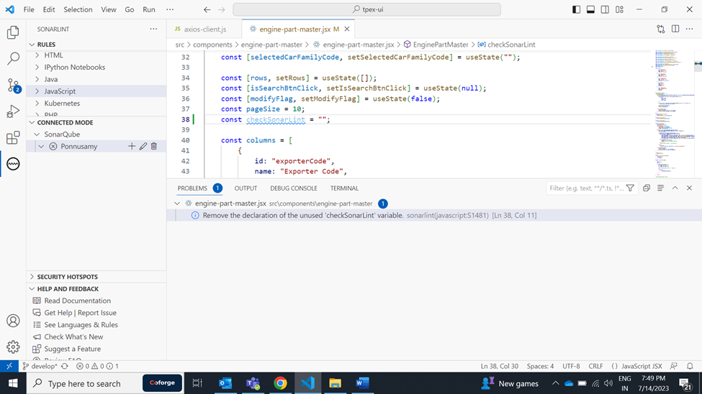
Ponnusamy

Slide 5
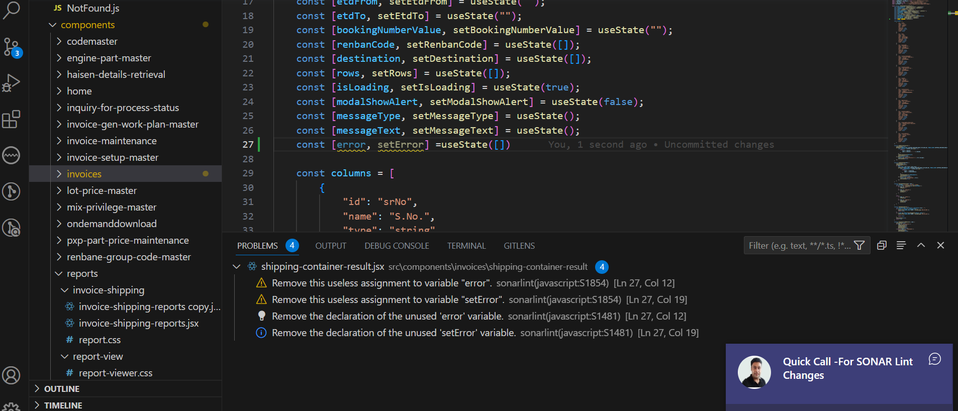
MOHD IMRAN

Slide 6
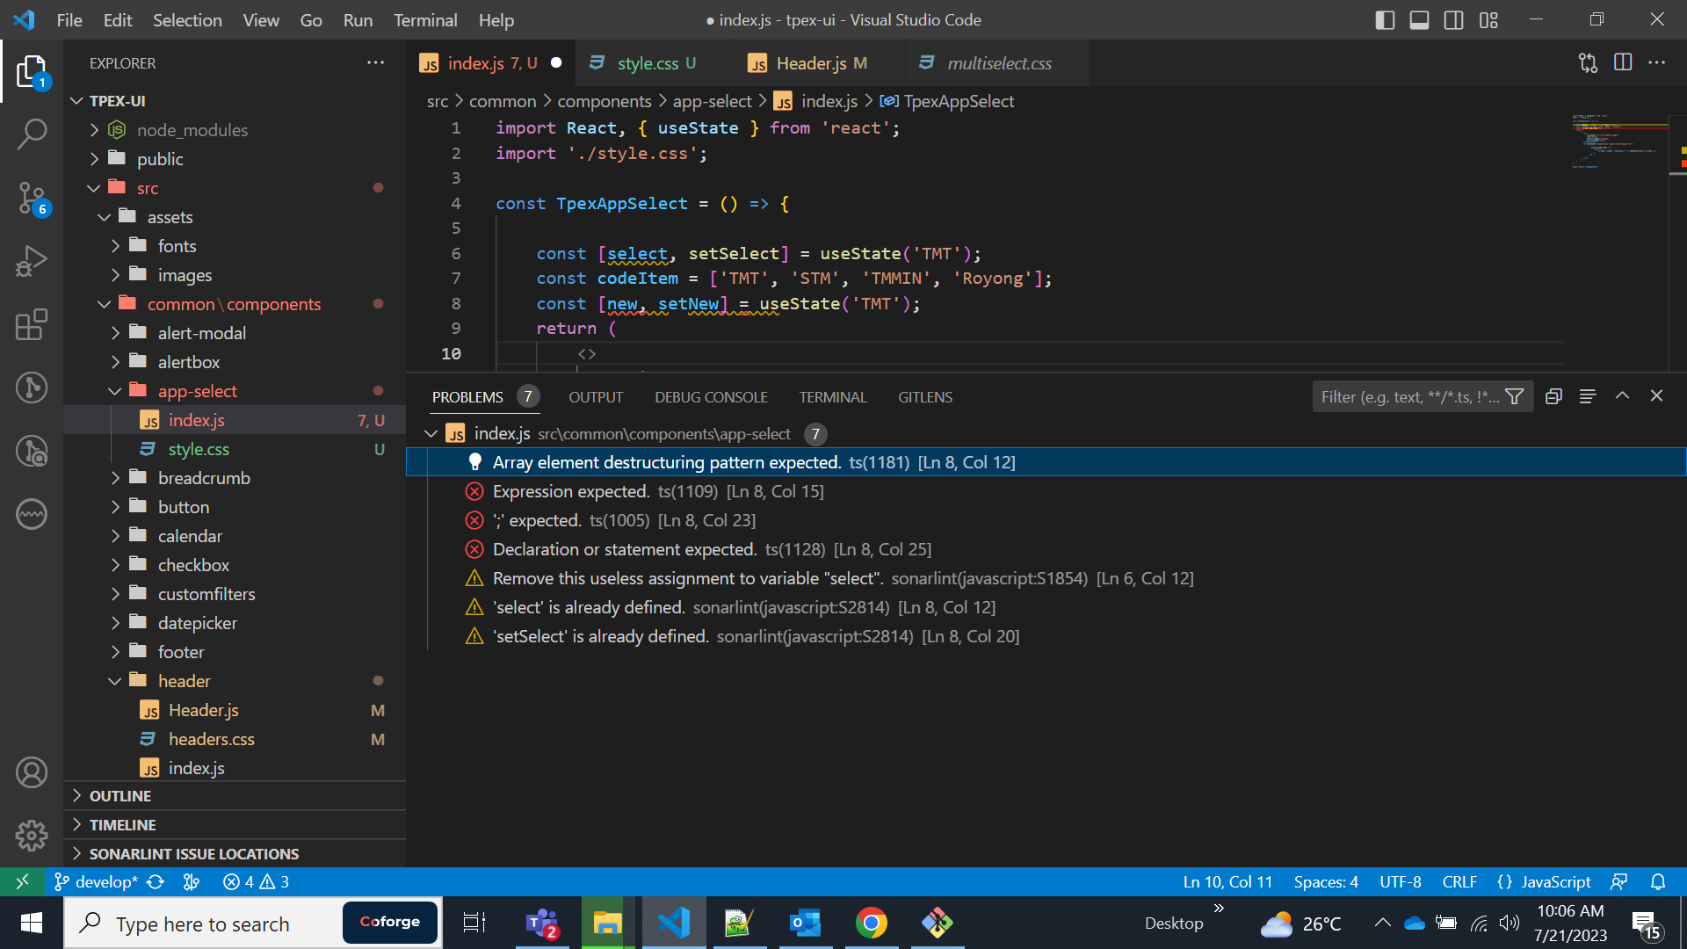
Raj Kumar

Slide 7
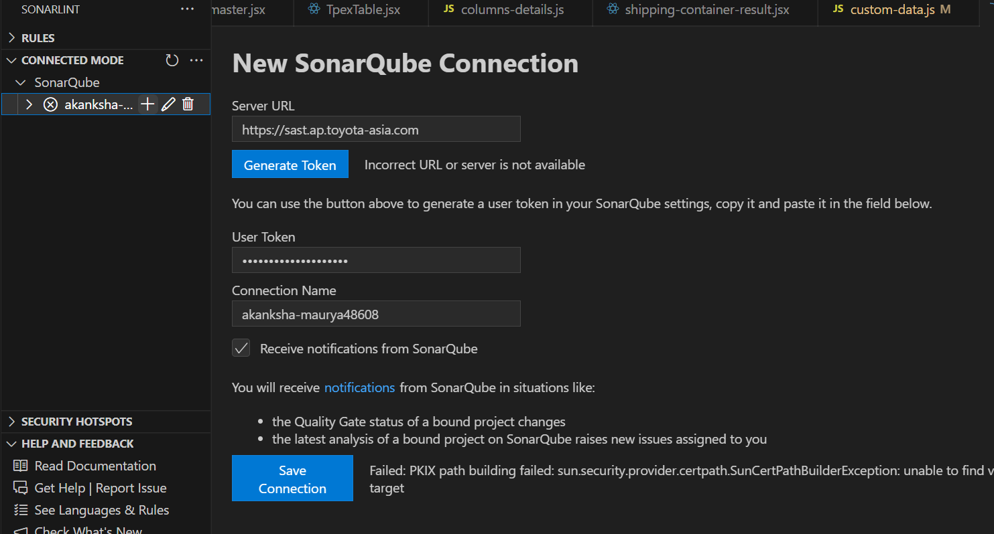
Akanksha Maurya

Slide 8
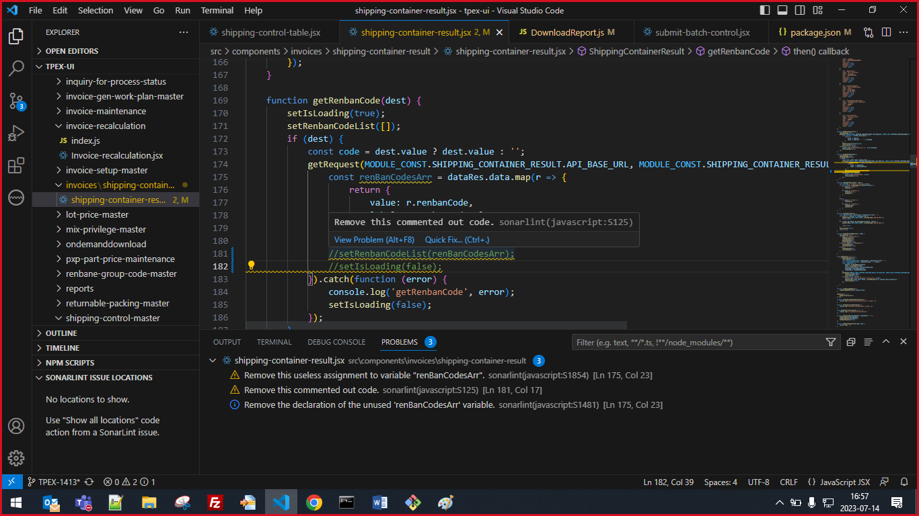
Pramod Kumar

Slide 9
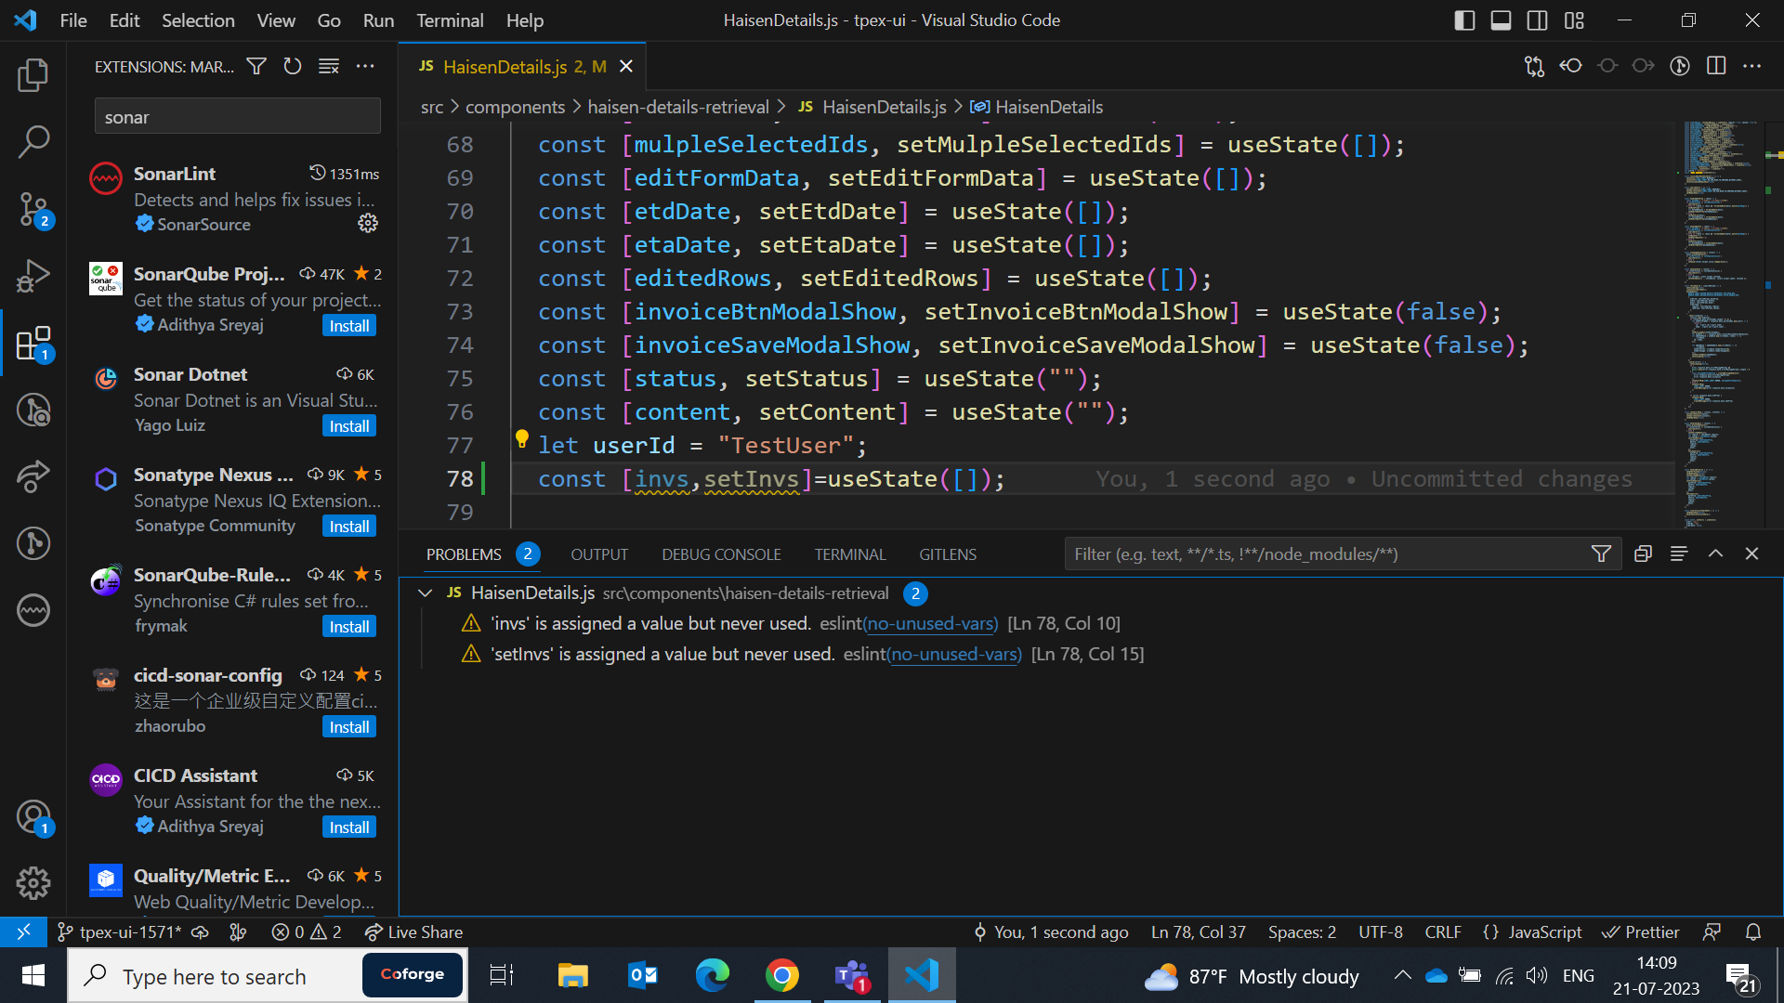
Bathula Yedukondalu

